Slide 1

Stockify
Model for Estimating Stock Performance (checkpoint 3)
By: Abdullah salau

Slide 2
Checkpoint Goals
Regression
Continuous Target Variable
Additional Preprocessing
Hyperparameter Optimization
Grid Search
Bayesian Optimization
Cross-Sector Performance

Slide 3
Regression
Continuous vs Categorical Target Variable
Linear Regression (Ordinary Least Squared)
Notes:
BEFORE IMPUTATION OF MISSING VALUE

Slide 4
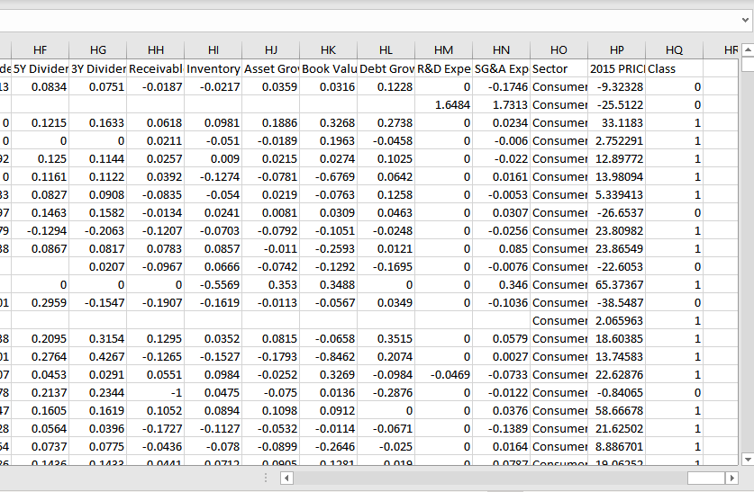
k
Notes:
We used a 50-Fold Cross Validation for Testing
50-60 features score the highest but the variance between scores is quite insignificant

Slide 5
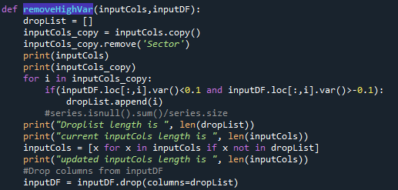
More Preprocessing
Removing Variables with Low Variance (2)
Notes:
Removed Variables with variance less than |0.1|

Slide 6
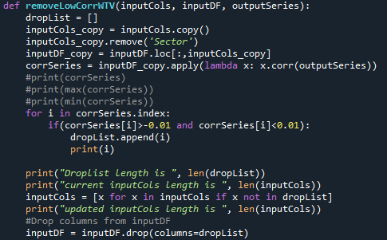
More Preprocessing
Removing Variables with Low Correlation with Target Variable (3)

Slide 7
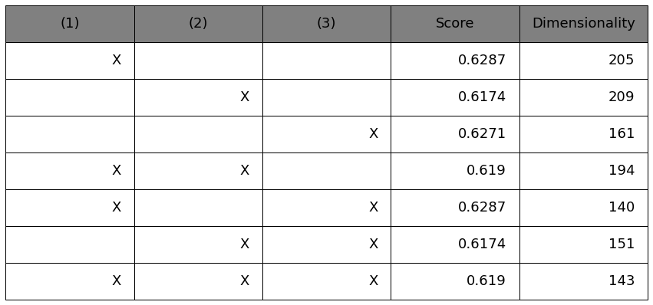
Preprocessing Results
Removing Variables with Missing Values
Removing Variables with Low Variance
Removing Variables with low Correlation with Target Variable
Notes:
We decide to use both 1 and 3, as this gives us the most optimal score AND efficiently reduces dimensionality

Slide 8
Feature Engineering
Log transformations
Hash encoding
Notes:
Feature Engineering already present from Checkpoint 1: Regularization and Basic One Hot Encoding, also Imputation of Missing Values

Slide 9
Log Transformations
Adopted with the intention of reducing the scale of variables with extremely high skew
Also done to try and center variables in order to reduce the effect of outliers

Slide 10
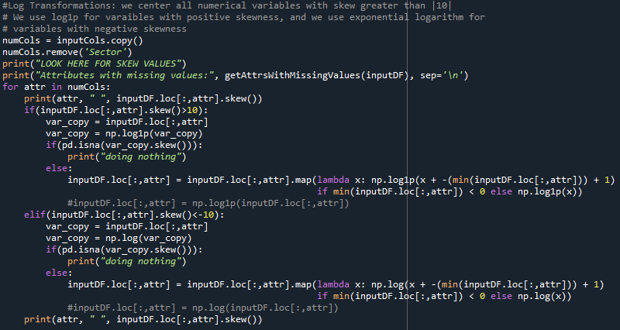
Implementation
Notes:
Couple of Notes:
We center all variables with skew greater |10|
We use log1p for variables with positive skewness, and we use exponential logarithm for variables with negative skewness
Higher order functions giving me a lot of errors, so we manually implement log transformation for each value in each variable
Since some values contain negative numbers, we add the minimum value of each variable +1 to every single value

Slide 11
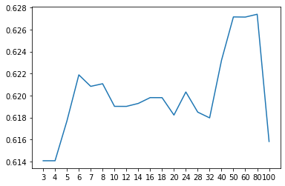
selectKBest before Log Transformation
Score
k

Slide 12
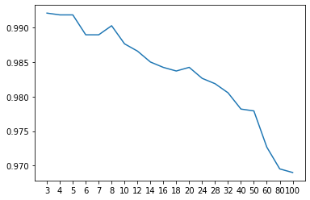
selectKBest after Log Transformation(!)
Score
k

Slide 13
Hash Encoding
Alternative to Basic One-Hot Encoding
Added benefit of reducing variable dimensionality

Slide 14
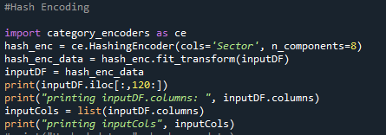
Implementation

Slide 15
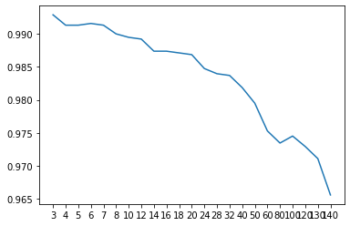
selectKBest after Log Transformation and Hash Encoding (n = 8)
Score
k

Slide 16
More Models
K-nearest neighbor
Gradient boosting machine

Slide 17
K-Nearest Neighbor
Model prediction based on k data points around value
Testing took LOADS of time

Slide 18
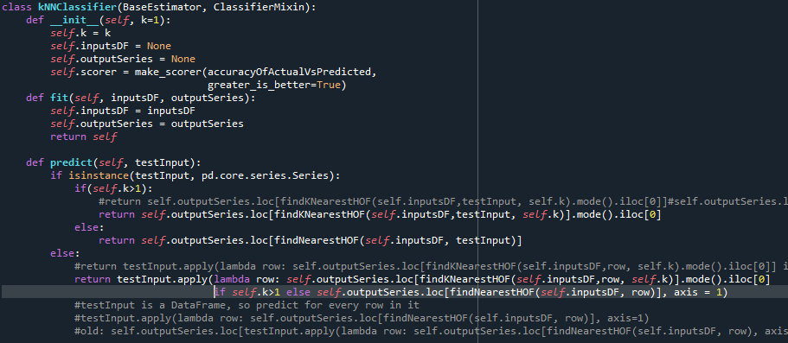
Implementation

Slide 19
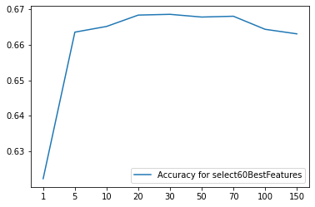
select60Best after Log Transformation and k-Nearest Neighbour Model
Score
k

Slide 20
Gradient Boosting Maching
Model prediction based additive ensembles, each one making model more accurate
Testing took even more time

Slide 21
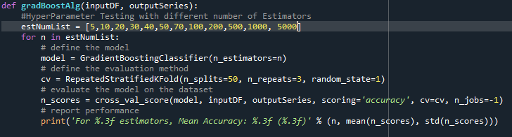
Implementation

Slide 22
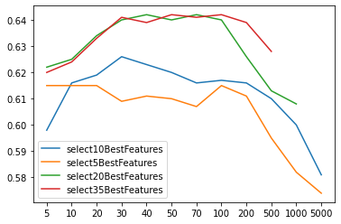
selectKBest before Log Transformation and GBM Algorithm
Score
Number of estimators

Slide 23
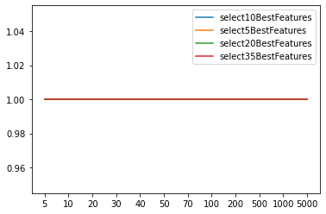
selectKBest after Log Transformation and GBM Algorithm
Score
Number of estimators

Slide 24
Thank you!

